Slide 1

Tactile Navigation Support for Blind Individuals
by
M. Joshika
Roll No. 204G1A0545
H. Arshia Parveen
Roll No. 204G1A0515
K. Hemanth Reddy
Roll No. 214G5A0506
G. Akshaya
Roll No. 214G5A0501
Under the guidance of
Dr. B. HariChandana M.Tech.Ph.D
Associate Professor
Department of Computer Science and Engineering
Srinivasa Ramanujan Institute of Technology
(Autonomous)
2023 - 2024

Slide 2

Contents
Abstract
Problem statement
Objectives of Project
Methodology
Expected Outcomes
Field of Application of Project
Tentative work Plan

Slide 3
Abstract
Sighted individuals possess the ability to navigate their surroundings with ease and utilize their visual facility to promptly identify potential hazards. Conversely, individuals who are visually impaired are unable to perceive the external environment, traverse independently, or discern danger. Moreover, they may occasionally feel distressed and wish to notify their family or friends of their location via text. So, the primary challenge faced by visually impaired individuals is their reliance on others, as even their closest relatives may not always be able to provide adequate care. To address this issue, a "Smart Stick" would be developed utilizing the "Internet of Things". Using a variety of sensors, including ultrasonic, soil moisture, RF, GPS-GSM modules and using Arduino UNO, the Smart Stick empowers blind people to be independent and gives them a sense of normalcy.
Keywords: Arduino UNO, Smart Stick, User Notification Setup.

Slide 4
Problem Statement
Blind persons always struggle with their daily tasks since they are unable to see even a single thing.
When using a standard blind stick, blind persons have trouble recognizing stairs and obstacles surrounded by them.
By making the use of smart blind stick, we can hear alert noises to identify stairs and obstacles.

Slide 5
Objectives of Project
Research Objective-1:To develop a model that will enable blind persons to navigate both familiar and unfamiliar places without the use of guides. To alarm the user through vibration to determine the obstacles direction sources.
Research Objective-2:To create a user-friendly interface that makes use of tactile feedback and sensations that are simple for blind users to grasp and interpret, enabling them to make independent.

Slide 6
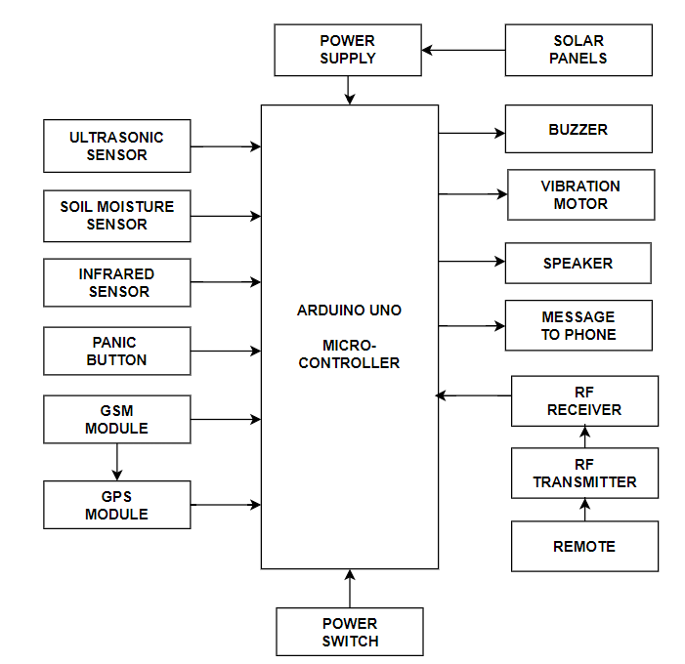
Proposed System
Fig 1.1 Block Diagram for proposed system

Slide 7
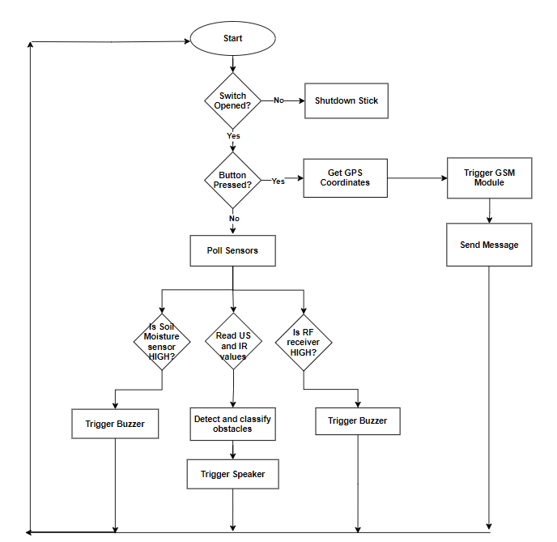
Design and implementation of first objective
Fig 1.2 Flow Chart for proposed system

Slide 8
Methodology
The proposed system is capable of detecting the surroundings for various barriers of different sizes and producing the required auditory using the ultrasonic sensor in the presence of buzzer. When damp surfaces are detected using sensors, it might alert the user by vibratory sounds and also enable to send SMS based on the user's location in an emergency or when they are having trouble. When the stick is misplaced, the user can find the stick by using an RF remote control.

Slide 9
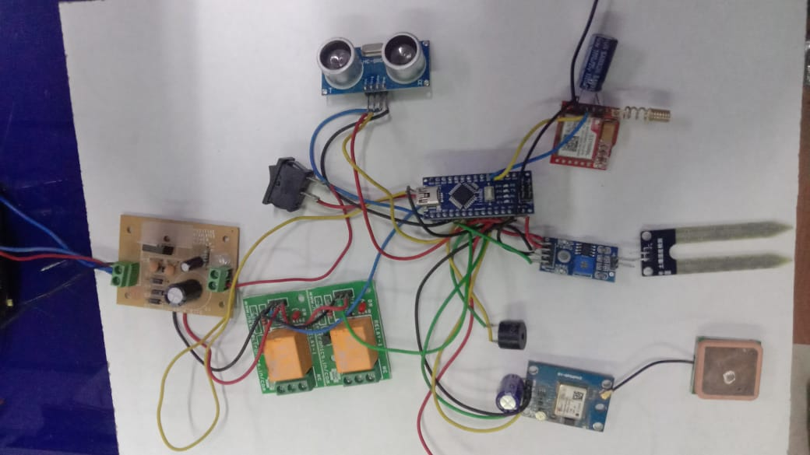
Methodology
Fig 1.3 Circuit Diagram

Slide 10
Expected Outcome
The Smart stick is an enhanced navigation and safety tool for visually impaired individuals. It equipped with features such as obstacle detection, moisture sensing, proximity awareness, GPS tracking, emergency SMS alerts, and audio feedback, is anticipated to significantly enhance the mobility and safety of visually impaired users. The successful integration of these technologies will provide users with real-time information about their surroundings, enable efficient navigation in diverse environments, and offer a reliable tool for emergency communication. To empower visually impaired individuals, providing them with increased independence and confidence in their daily lives.

Slide 11
Field of Application of Project
The Smart stick is versatile, finding application in urban navigation, outdoor exploration, and emergency situations for visually impaired individuals, providing a reliable aid for enhanced mobility and safety.

Slide 12
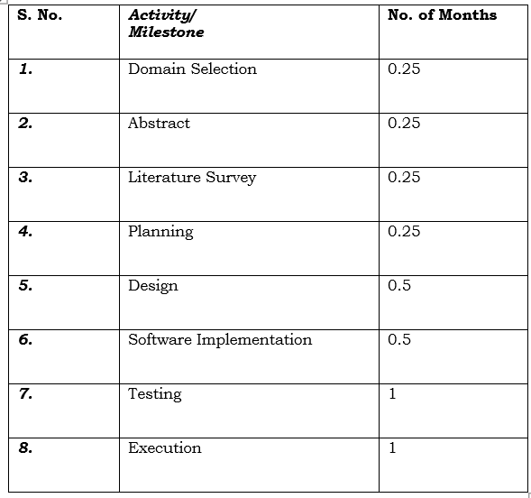
Tentative Work Plan
Activity Plan:

Slide 13
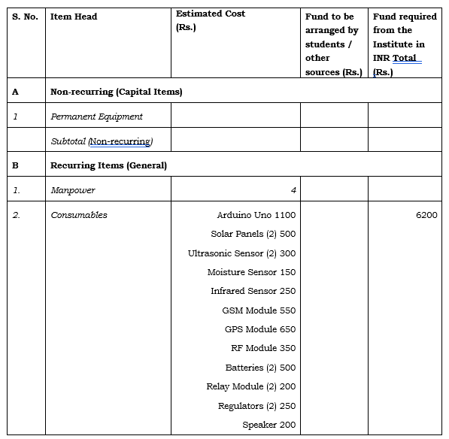
Estimated Budget

Slide 14
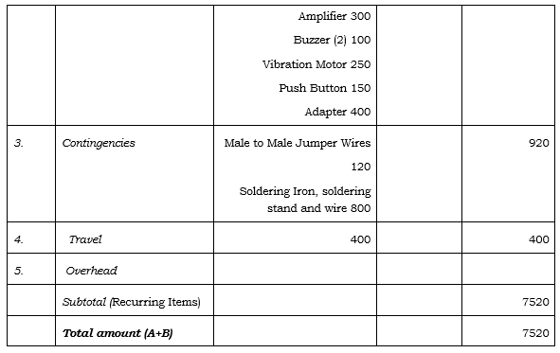
Estimated Budget

Slide 15
Any Queries?

